Slide 1
RNA EXTRACTION USING
QIAamp VIRAL RNA MINI KIT (Qiagen)

Slide 2
Learning Objectives
At the end of this training, the trainee will be able to:
Understand biosafety practices associated with RNA extraction from clinical specimens
Explain the conditions and factors affecting extraction
Understand sample handling and storage
Understand the principle of RNA extraction
Perform viral RNA extraction using the Qiagen QIAamp Viral RNA Mini kit

Slide 3
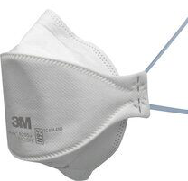
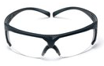
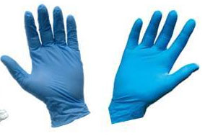
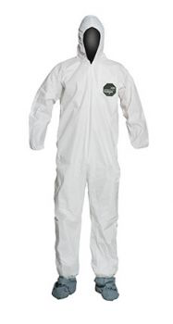
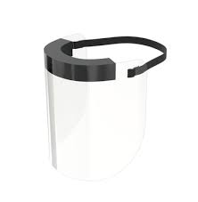
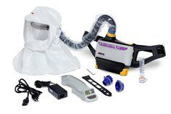
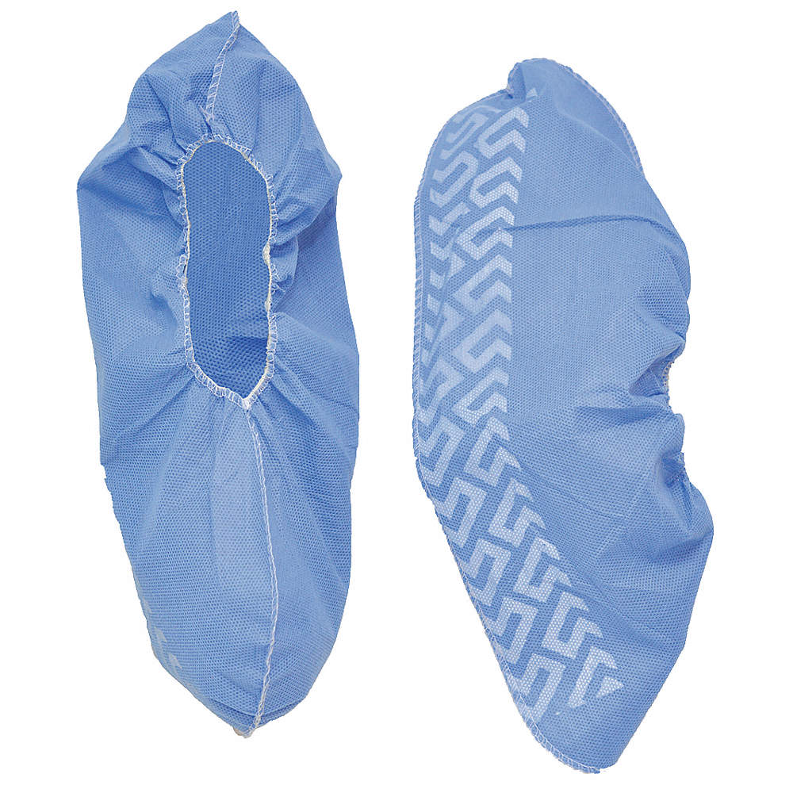
Biosafety Considerations
Clinical specimens are potentially infectious and need to be handled and processed in a way that minimizes the risk to the laboratorian.
N95 respirator
1. Don proper personal protective equipment (PPE) as recommended by risk assessment
Safety glass
Gloves
Face shield
Tyvek coveralls
Hood + PAPR
Shoe Covers
Notes:
Shown are examples of different types of PPE that might be worn, depending on risk assessment and availability.

Slide 4
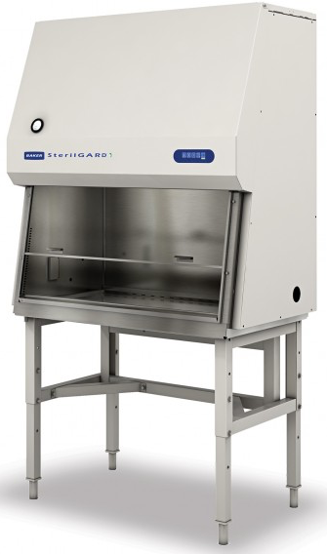
Biosafety Considerations
Clinical specimens are potentially infectious and need to be handled and processed in a way that minimizes the risk to the laboratorian.
2. Process clinical specimens in a Biological Safety Cabinet (BSC) that has been certified as operating within the manufacturer’s specifications within the last year.

Slide 5
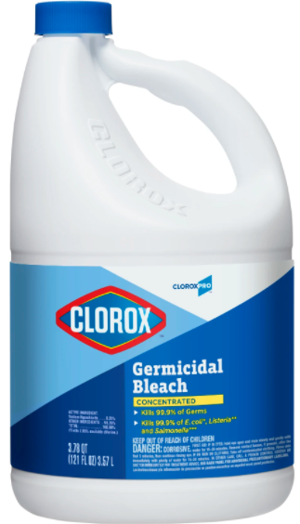
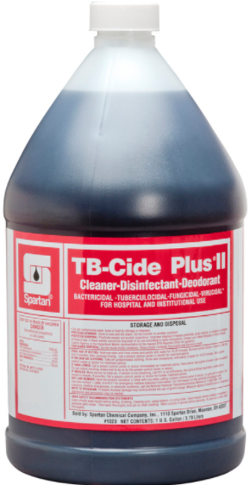
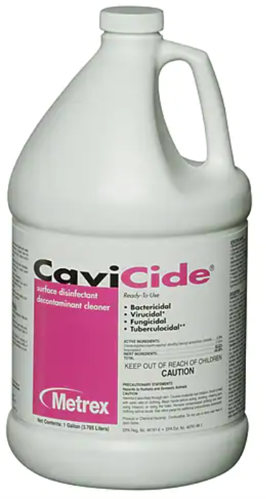
Biosafety Considerations
Clinical specimens are potentially infectious and need to be handled and processed in a way that minimizes the risk to the laboratorian.
Use an appropriate decontamination solution at the correct concentration, making sure to expose the potentially contaminated surface and/or material to the solution for the appropriate contact time
Sodium hypochlorite (bleach)
Alcohol (ethanol, isopropanol)
Hydrogen peroxide
Phenolic compounds
Quaternary ammonium compounds

Slide 6
Summary of Biosafety Considerations
Appropriate personal protective equipment (PPE), based on a risk assessment, should be worn through the whole process
Handling and processing of clinical samples should be done in a certified class II biological safety cabinet (BSC) with HEPA filters to protect the sample from environmental contamination, the laboratory worker from the sample, and the environment from the sample
The biological safety cabinet, micropipettes and other equipment, and other working areas should be decontaminated using appropriate decontaminants

Slide 7
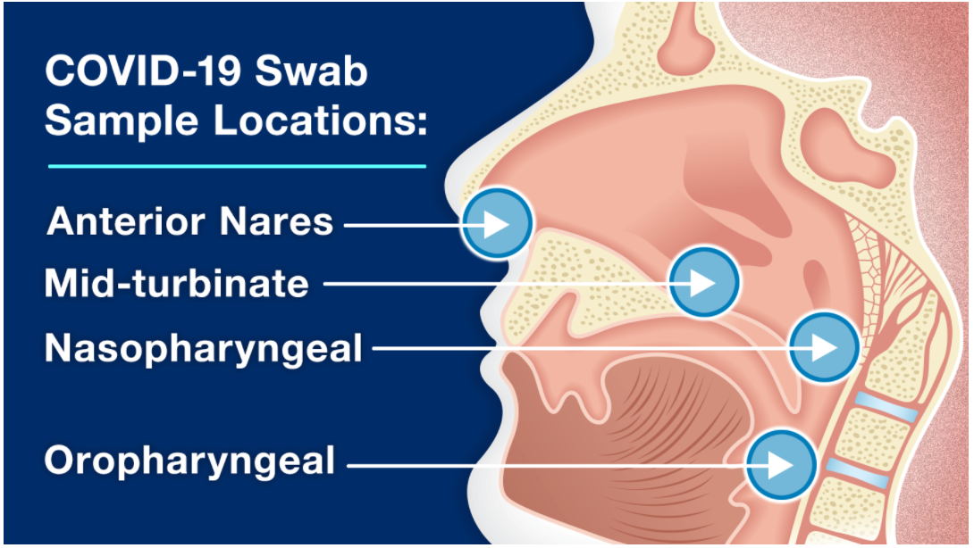
Clinical Specimen Types and Handling
Clinical specimens are:
Swabs in viral transport medium:
Nasopharyngeal
Oropharyngeal
Anterior nares (nasal)
Nasal mid-turbinate
Nasopharyngeal wash/aspirate
Nasal wash/aspirate
Sputum
Endotracheal aspirate or broncho-alveolar lavage fluid (BAL)
Storage
2-8 ºC for up to 72 hours (short-term storage)
-20 ºC or colder (long-term storage)
Notes:
Image from https://www.fda.gov/consumers/consumer-updates/coronavirus-disease-2019-testing-basics

Slide 8
Precautions when Working with RNA
RNA stands for RiboNucleic Acid
Working with RNA is more demanding than working with DNA
RNA is very unstable, and is easily degraded by RNAses
RNases are enzymes that degrade RNA
Difficult to inactivate, even by prolonged boiling or autoclaving
Present in dust, skin secretions, bodily fluids, and ungloved hands
Active at room temperature, 4°C, and colder, although freezing reduces the rate of degradation
Small amounts can destroy RNA in a sample, leading to a false negative test result
Solutions such as RNAse Away can remove RNAses from surfaces
Wear gloves at all times when preparing and working with RNA, and change them if you touch bare skin or undecontaminated equipment/surfaces

Slide 9
Precautions when Working with RNA
Use filtered, RNAse-free pipette tips and RNAse-free tubes
Change out pipette tips if there is a chance the tip has touched a surface
Decontaminate working surfaces, equipment, tubes, with bleach, RNase AWAY, and alcohol.
Clean and decontaminate the working area and laboratory frequently
All reagents and consumables used should be RNase-free
Prepare single-use aliquots of reagents in a genome-free space (such as where master mix is prepared) to minimize the risk of contaminating them through reuse
Store extracted RNA in small single-use aliquots at -80 ºC (long-term storage) or -20 ºC (short-term storage). Avoid repeated freeze/thaw cycles

Slide 10
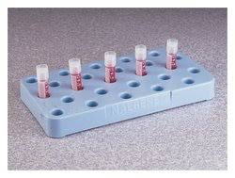
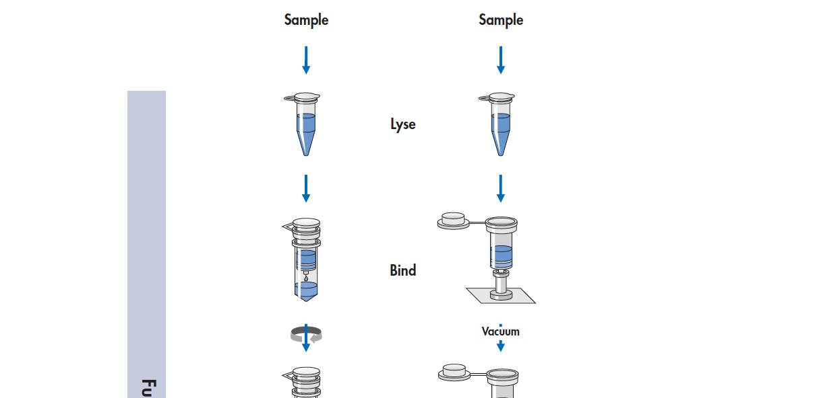
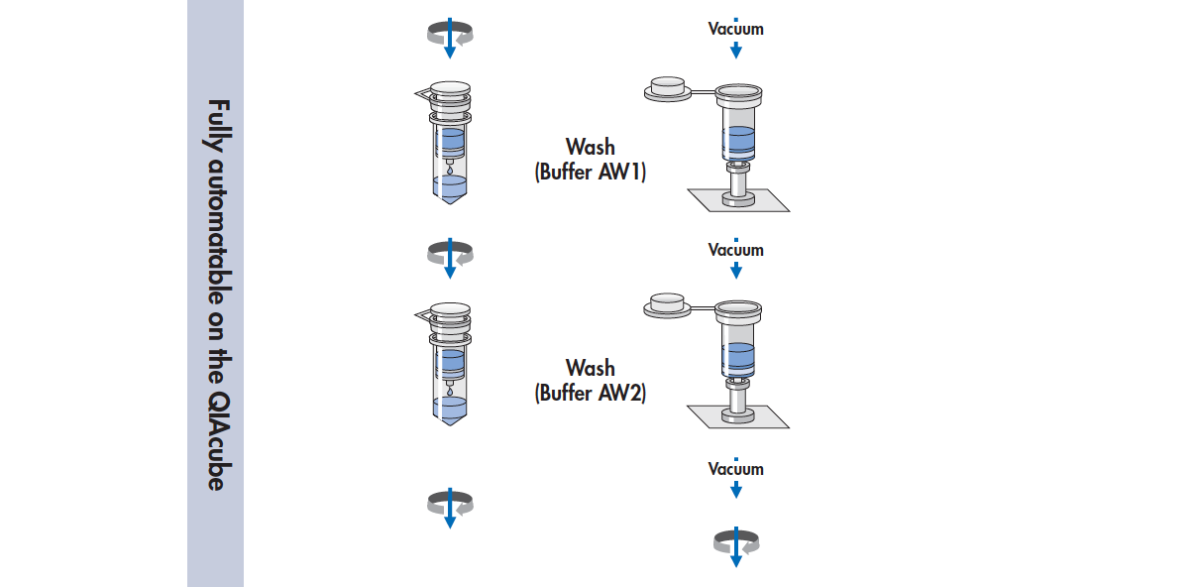
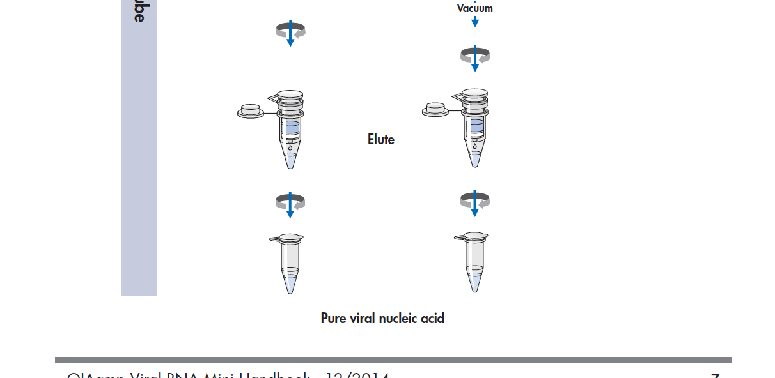
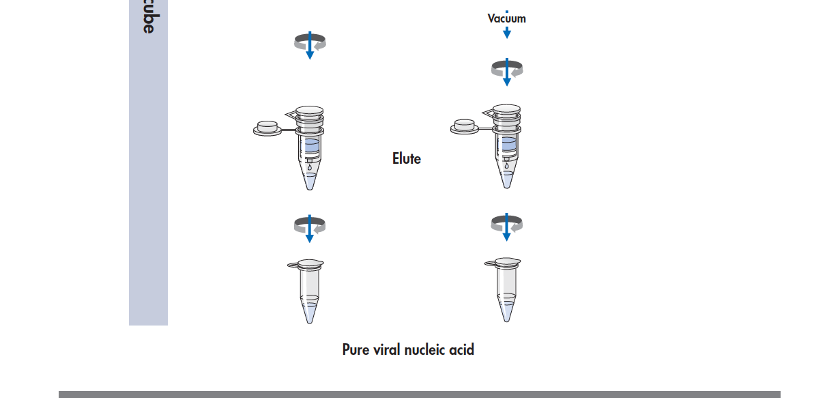
Overview of RNA Extraction
Clinical specimen
Samples
Lysis of samples using a lysis buffer
Lyse
Lysates transferred to spin column for binding
Bind
Columns are washed 2X
Wash (2X)
Nucleic acids are eluted
(RT-PCR, sequencing, …)
Elute
Pure RNA

Slide 11
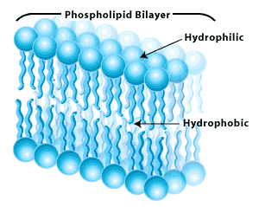
Lysis and Nucleic Acid Precipitation
Lysis is done with lysis buffer (buffer AVL) containing chaotropic salt that:
Breaks down cell membrane, viral envelope and capsid and free nucleic acids
Solubilizes hydrophobic regions in lipid bilayers
Denatures proteins by disrupting the tertiary structure
Inactivate enzymatic proteins activity (this will inactivate RNases and prevent RNA from degradation)
Disrupts weak bonds between molecules
Addition of absolute ethanol
Ethanol brings nucleic acid out of aqueous solution (salting out)

Slide 12
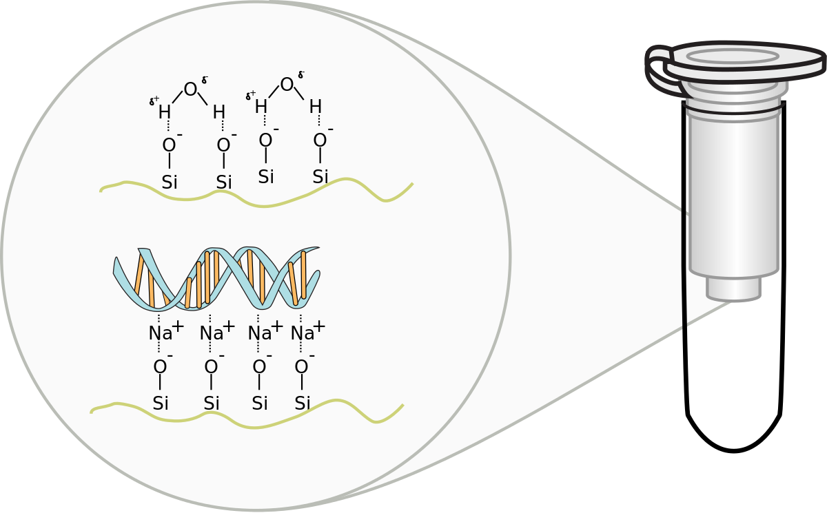
RNA Binding to QIAamp Spin Column Membrane
Nucleic acids bind to silica-based membrane in the spin column under:
Optimal pH and salt conditions
Lysates
spin
Bind

Slide 13
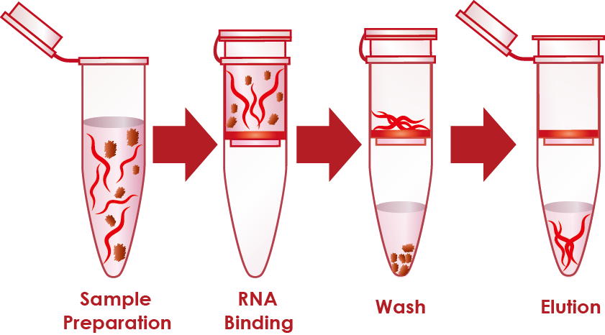
Washing the QIAamp Spin Column
Column is washed with Wash Buffer AW1 that:
Leaves nucleic acids bound to filter membrane
Remove contaminants from the filter membrane that flow through

Slide 14
Washing the QIAamp Spin Column
Column is washed with Wash Buffer AW2 that:
Leaves nucleic acids bound to filter membrane
Remove residual contaminants from filter membrane that flow through

Slide 15
Elution of Bound RNA from QIAamp Spin Column
Nucleic acid is eluted with Buffer AVE that:
Releases bound nucleic acids from the membrane
Allows nucleic acids to flow through the membrane
Purified RNA is collected in clean tube and ready for downstream application (RT-PCR, sequencing, …)

Slide 16
Extraction of SARS-CoV-2 Viral RNA from Naso/Oropharyngeal Samples (QIAamp Viral RNA Mini Kit, Cat#52904 or 52906)

Slide 17
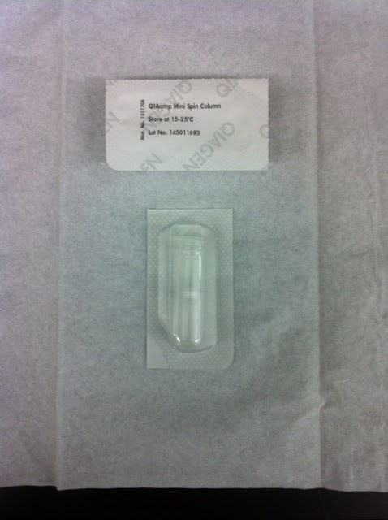
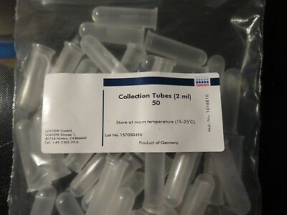
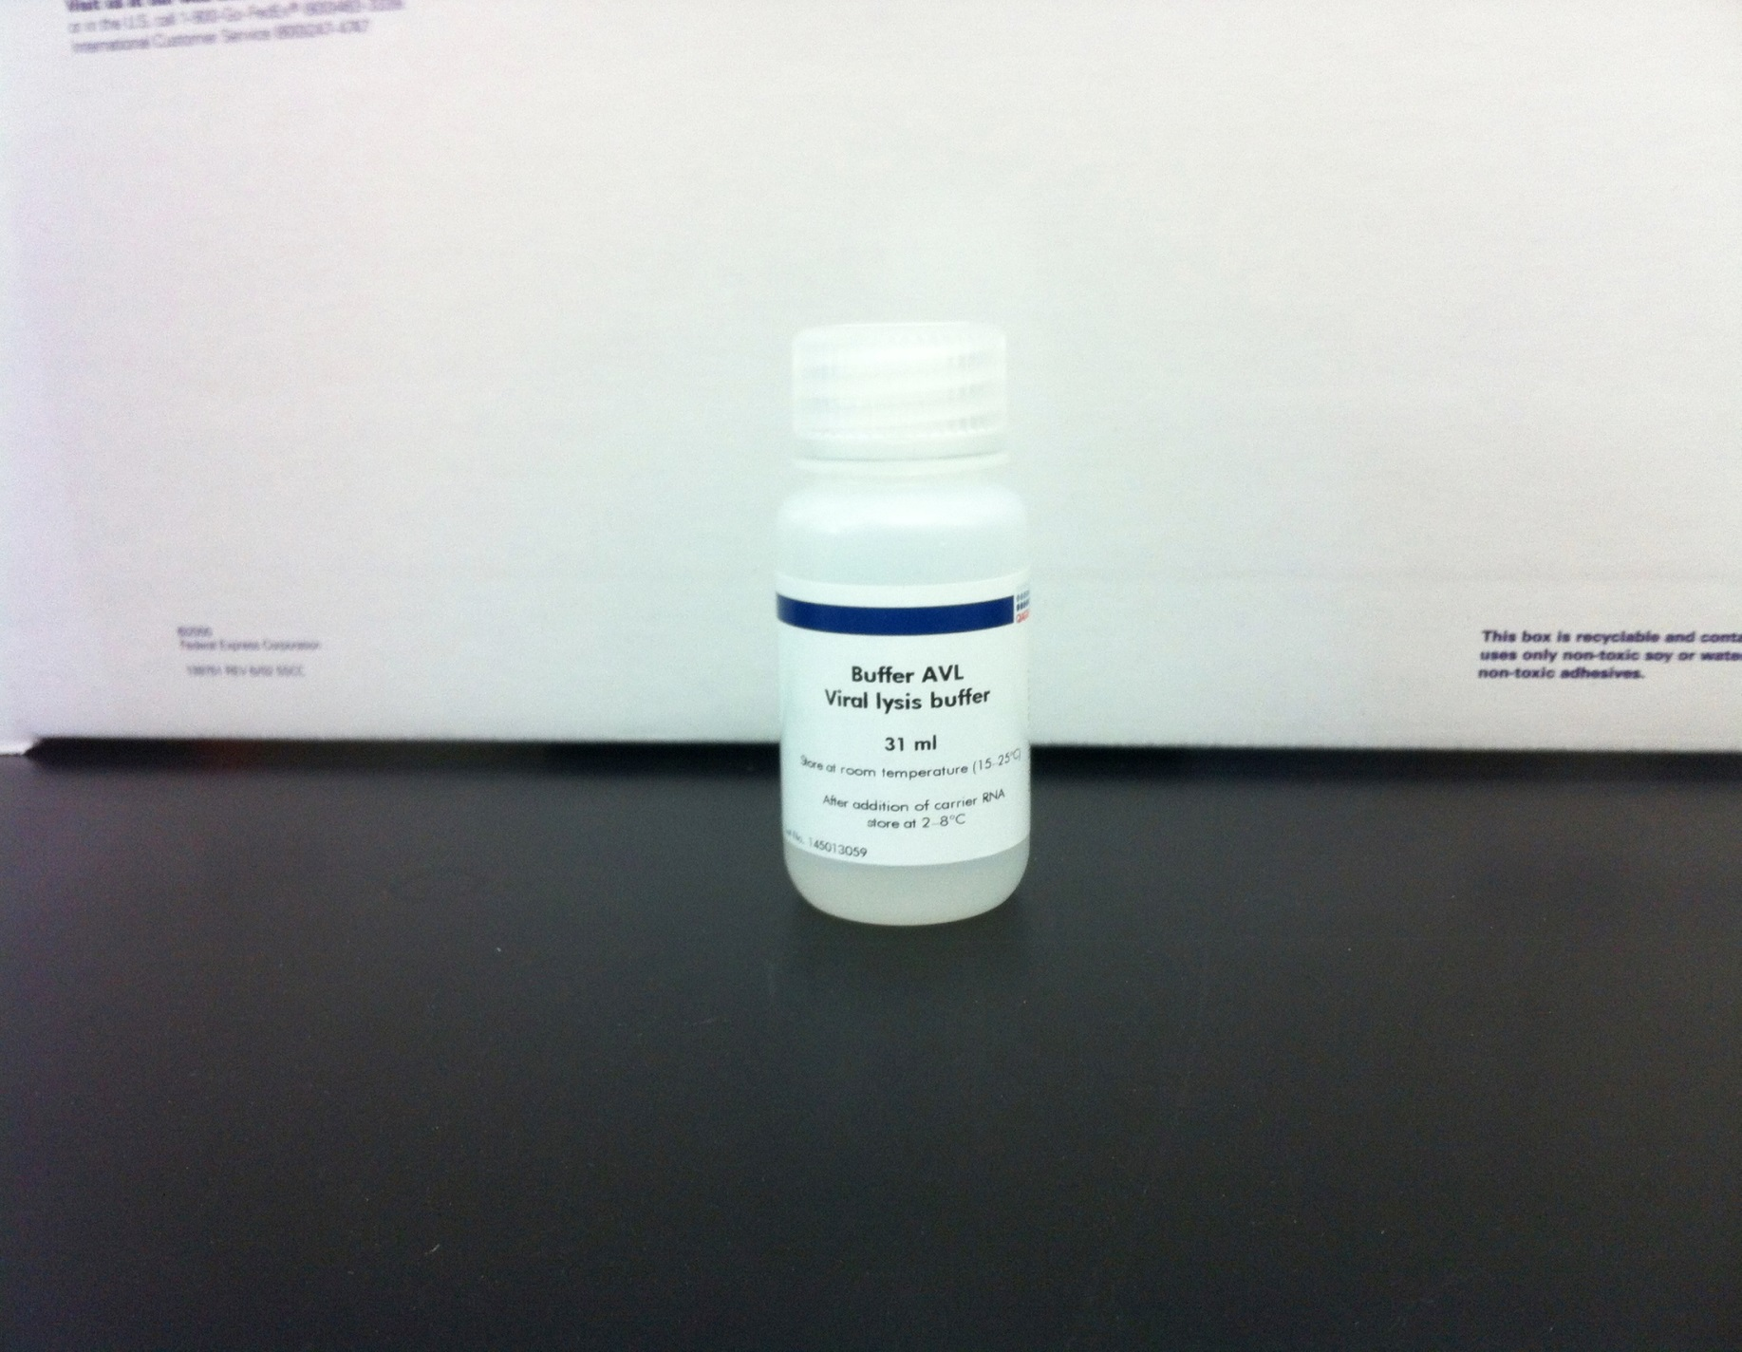
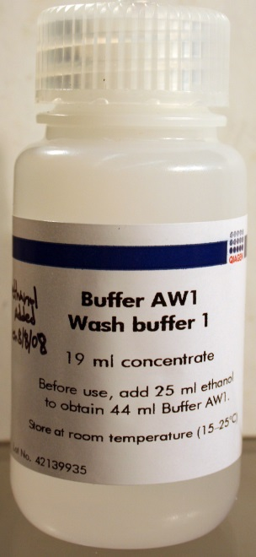
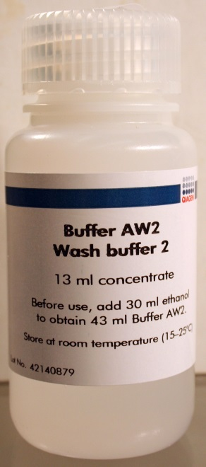
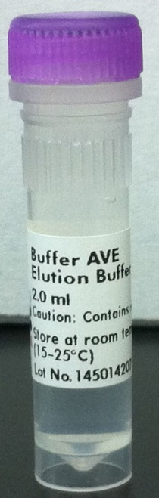
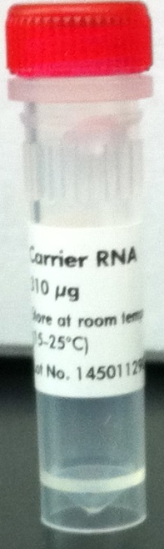
Kit Contents and Required Reagents
Kit contents
Mini Spin Columns
Collection Tubes (2 mL)
Lysis buffer (AVL)
Carrier RNA (will not be used)
Wash buffer AW1 (Concentrate)
Wash buffer AW2 (Concentrate )
Elution buffer (AVE)
Reagents Required but not provided
Ethanol (96-100%)
RNase-free microcentrifuge tubes
RNase-free pipettes and pipette tips
Microcentrifuge
Not used

Slide 18
Things to do Before Starting
Equilibrate samples to room temperature (15–25°C)
Equilibrate Buffer AVE to room temperature for elution step
Add the required volume of ethanol to Buffer AW1 and Buffer AW2 (check the box and write date and your initials)
If any buffers are cloudy or contain crystals, warm the bottles until they are clear and the crystals are gone.
NB: Carrier RNA will not be used : So no carrier RNA should be added to Buffer AVL

Slide 19
Preparing for the Extraction
Don appropriate PPE based on risk assessment
Clean Biological Safety Cabinet (BSC) with 10% Bleach Solution
Clean BSC with RNase AWAY decontamination solution
Clean BSC with 70% Alcohol solution
Wipe down all reagents and consumables (e.g. tip boxes) with RNase AWAY solution
Load reagents and consumables in the BSC

Slide 20
Preparation of Reagents
Add 25 mL ethanol
Add 30 mL ethanol

Slide 21
Lysis of Samples
Pipet 560 µL Buffer AVL into 1.5 mL Eppendorf tube
Mix clinical sample by vortexing for 15 sec and add 140 µL sample to buffer AVL in the microcentrifuge tube
Mix well by pulse-vortexing for 15 sec and incubate at room temperature (15-25 ºC) for 10 minutes
Briefly centrifuge the tube for 2 sec to remove drops from inside the lid
Add 560 µL of ethanol (96-100%) to the sample and mix by pulse vortexing for 15 sec, then briefly centrifuge for 2 sec

Slide 22
Binding of Lysates to Mini Column Membrane
Carefully transfer 630 µL of lysates (step 5) to the QIAamp Mini Column
Close the cap and centrifuge @ 6,000 x g for 1 minute
Place the QIAamp Mini Column into a clean 2 mL collection tube and discard the tube containing the filtrate
Carefully open the QIAamp Mini Column and transfer remaining lysates to the column
Close the cap and centrifuge @ 6,000 x g for 1 minute
Place the QIAamp Mini Column into a clean 2 mL collection tube and discard the tube containing the filtrate

Slide 23
Washing the Mini Column Membrane
Carefully open the QIAamp Mini column and add 500 µL Buffer AW1. Close the cap and centrifuge @ 6,000 x g for 1 minute
Place the QIAamp Mini Column into a clean 2 mL collection tube and discard the tube containing the filtrate
Carefully open the QIAamp Mini column and add 500 µL Buffer AW2. Close the cap and centrifuge @ 20,000 x g for 3 minutes
Place the QIAamp Mini Column into a clean 2 mL collection tube and discard the tube containing the filtrate
Close the cap and centrifuge @ 20,000 x g for 1 minute

Slide 24
Elution of Bound RNA from Mini Column Membrane
Place the QIAamp Mini Column into a clean 1.5 mL microcentrifuge tube and discard the tube containing the filtrate
Carefully open the QIAamp Mini column and add 60 µL Buffer AVE. Close the cap and incubate at room temperature for 1 minute
Centrifuge @ 6,000 x g for 1 minute
Collect eluate (RNA) and discard the QIAamp Mini Column
Use purified RNA in downstream application (RT-PCR, sequencing, …)

Slide 25
Reference
QIAamp Viral RNA Mini Kit Handbook (Qiagen)
Laboratory Biosafety Manual. 2004. World Health Organization (WHO) Geneva. Third edition

